Slide 1
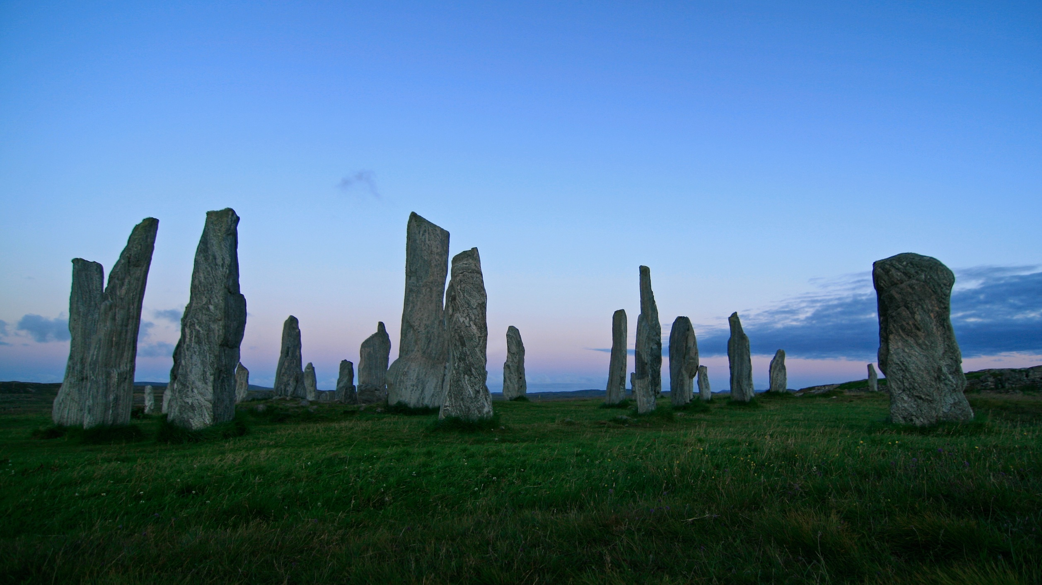

Anett Richel
Lukas Qualo
Ben Samtleben
Project for a calendar web application

Slide 2
What you need to know
What is the vision behind EventLAB?
What expectations do users have on our application?
Who is creating EventLAB?
How do we organize our team?
How is EventLAB designed?
How do we fulfill quality standards?
What is the current status?

Slide 3
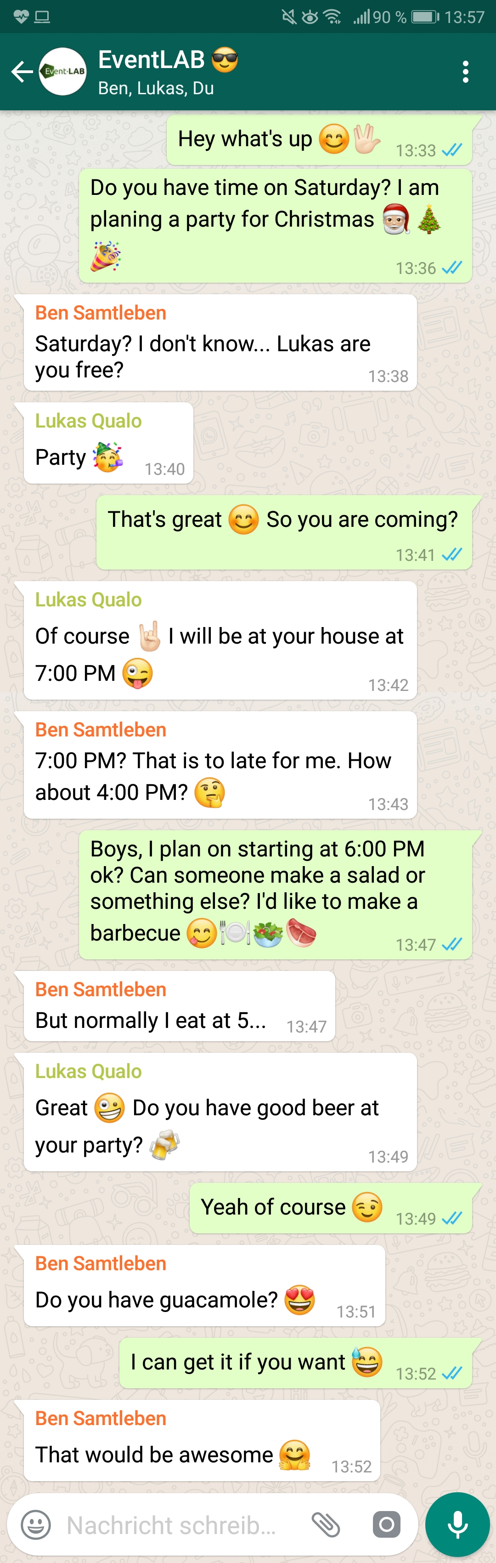
Motivation
Endless discussions about:
When and where do we meet?
Who will bring what?
Can everyone attend?
Scrolling through loads of different groups & messages
Confusion included for free!

Slide 4
Our Vision Why should you choose EventLAB?
Intuitive Easy-to-use for everybody
Organized Events organized in groups, each event has its own what-to-bring list
Simple No unnecessary features. Just focus on your task!
Accessible A global web application for people around the world
Inventive Useful features, inspired by successful applications

Slide 5

Our Vision
Combining the very best features of various calendar applications!

Slide 6

Our Team
U
K
A
S
N
E T T
E
N

Slide 7
Our Team
LUKAS
Project Manager, Implementer, Test Designer
Product Owner, Designer, Configuration Manager
Tech Writer, Course Developer, Tester, Scrum Master
ANETT
BEN

Slide 8
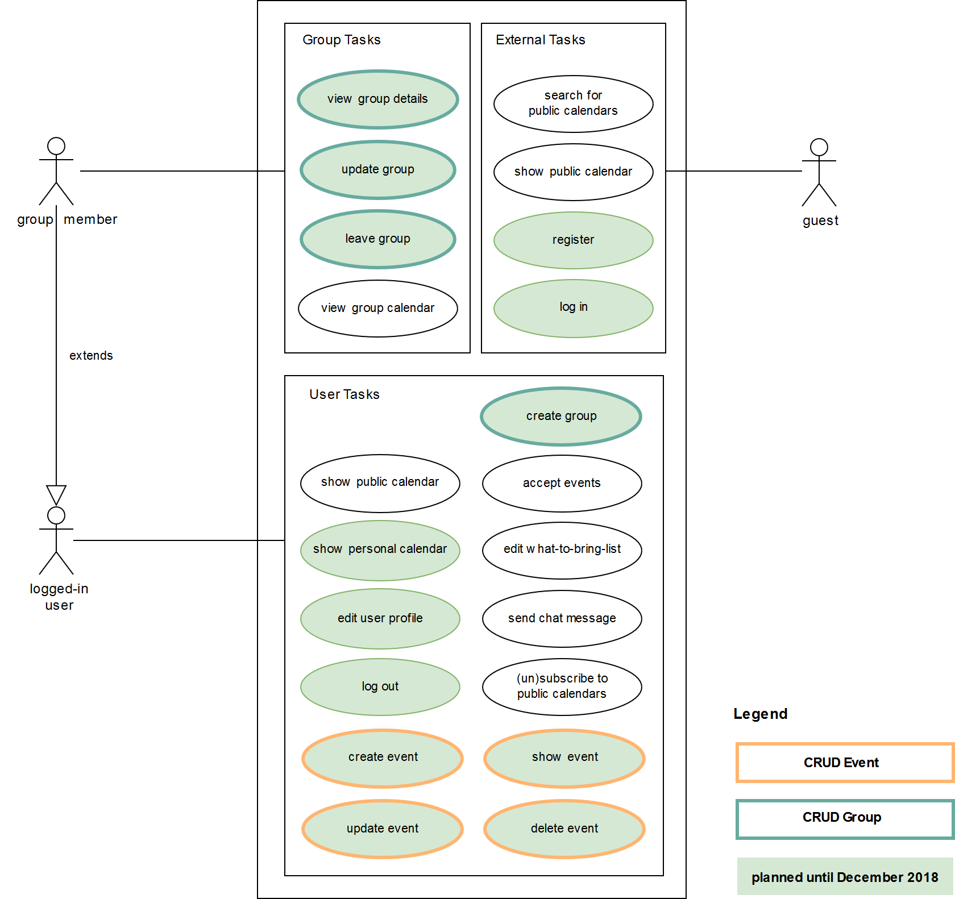
Tasks & Expectations

Slide 10
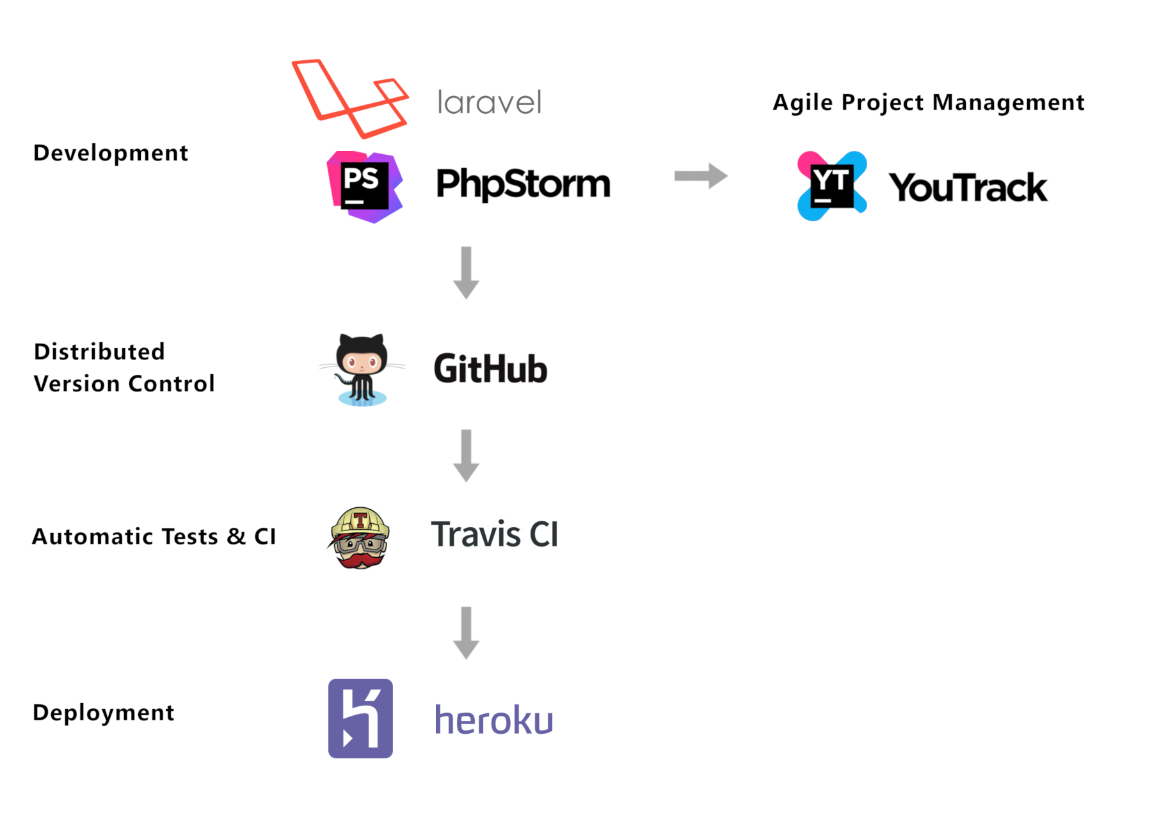

Project Overview

Slide 11
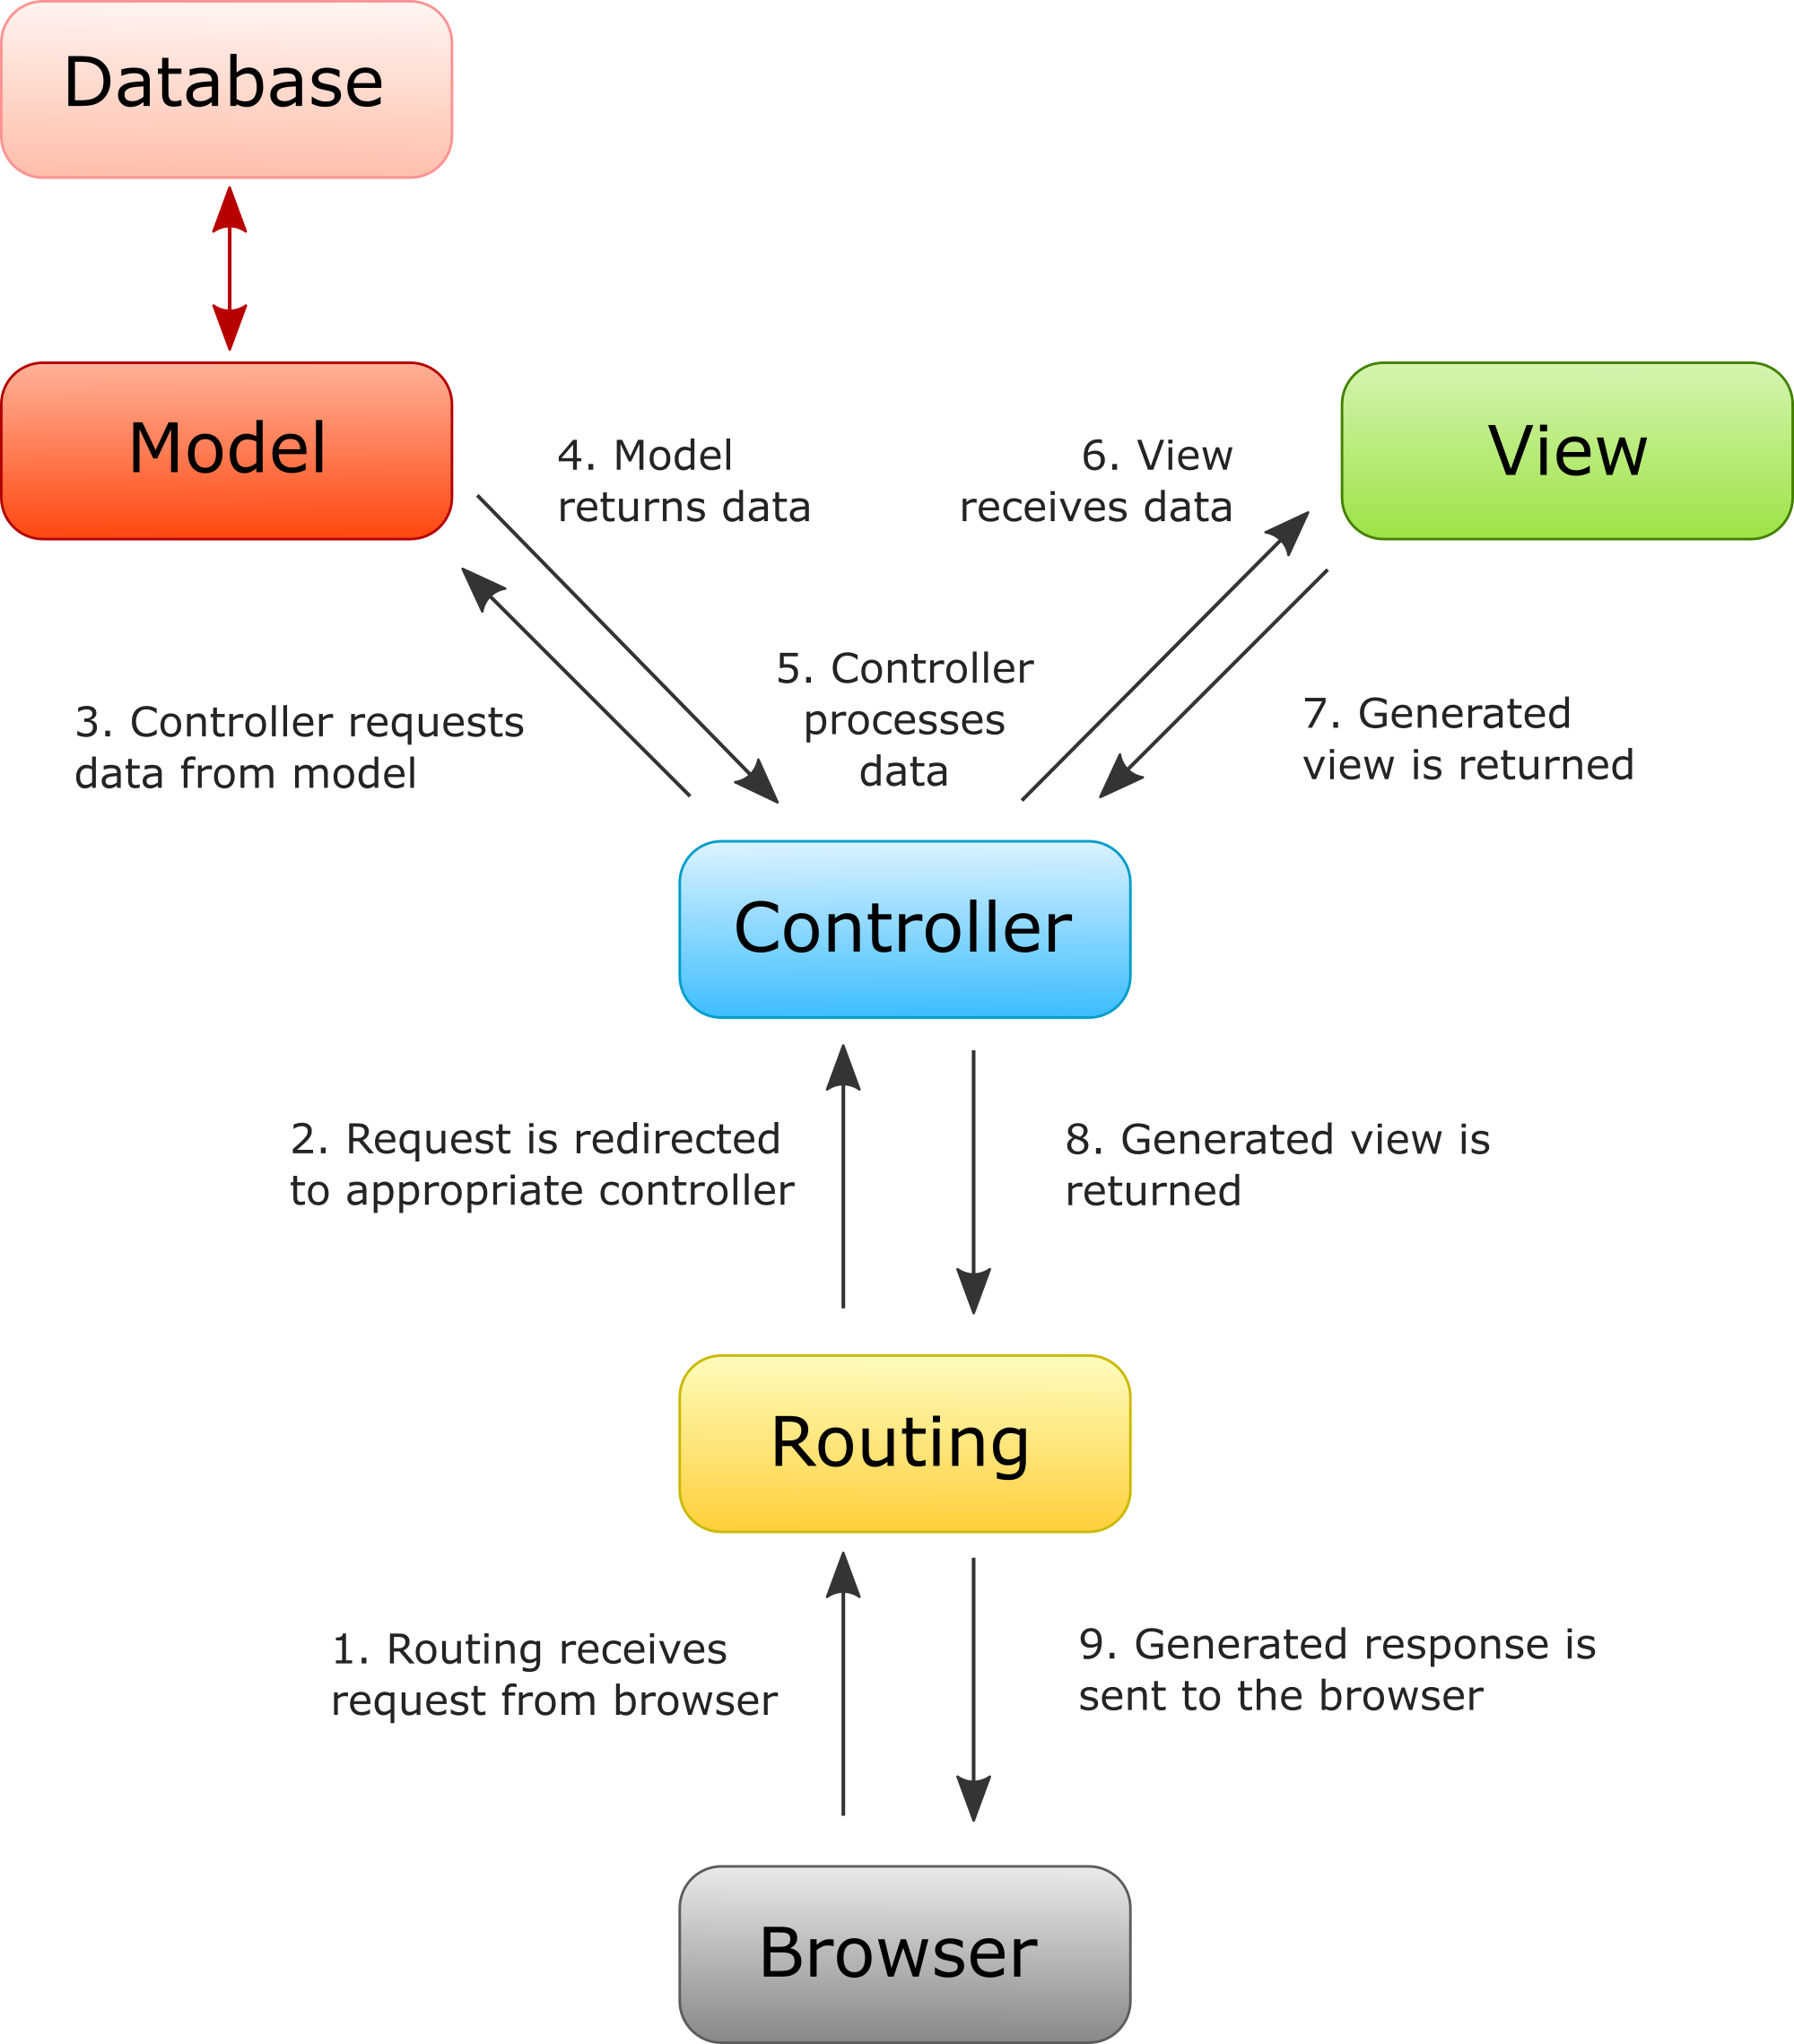

M V C A R C H I T E C T U R E

Slide 12
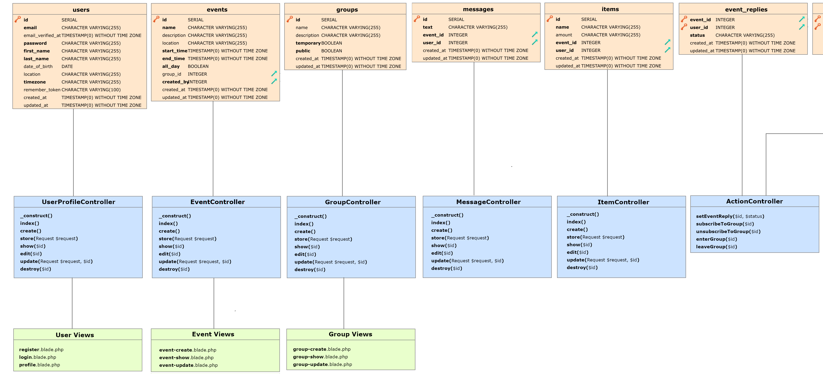
Class Diagram

Slide 13
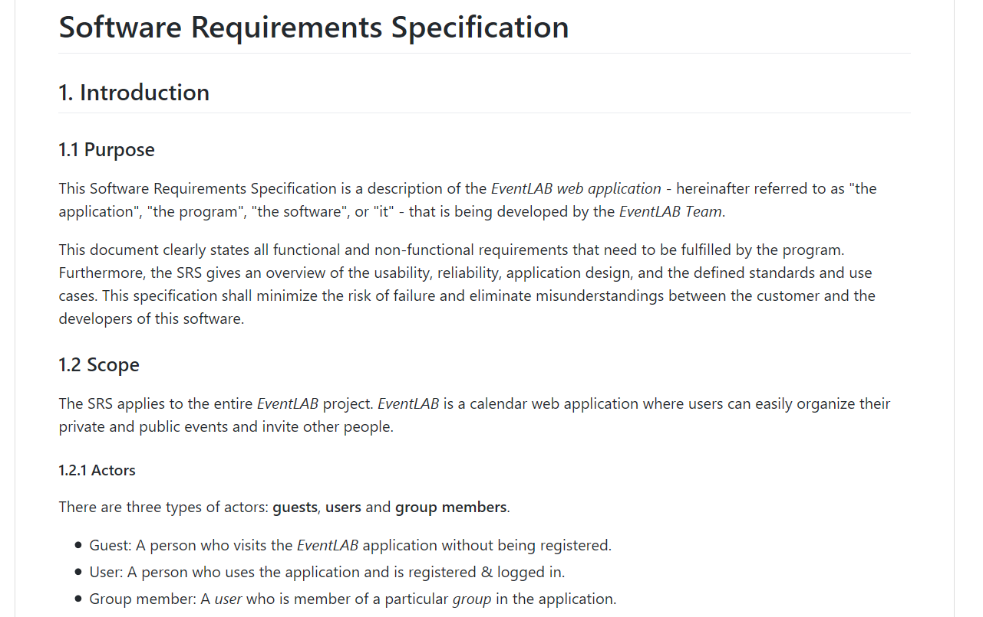
Quality
Software requirements specification clarifies all requirements and use case expectations
Software architecture document for project structure and clean hand-over

Slide 14
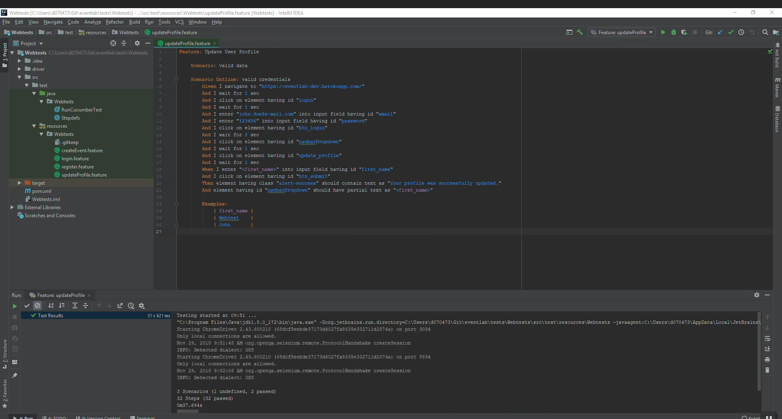
Quality

Slide 15
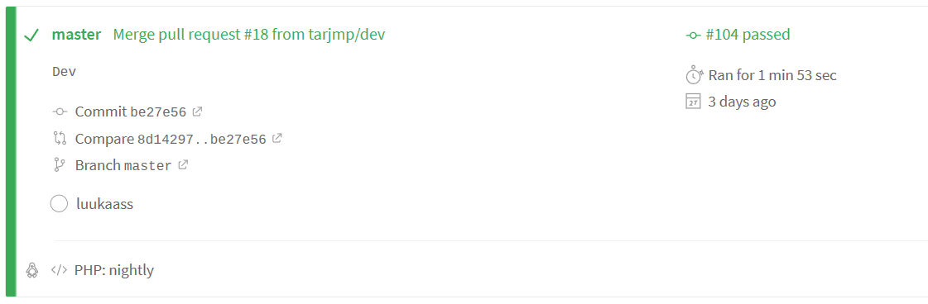
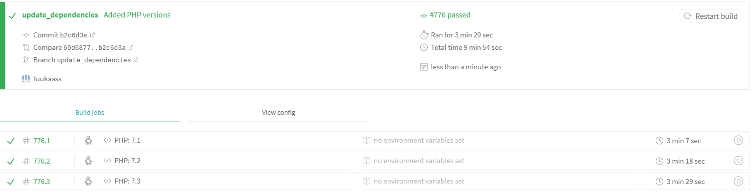
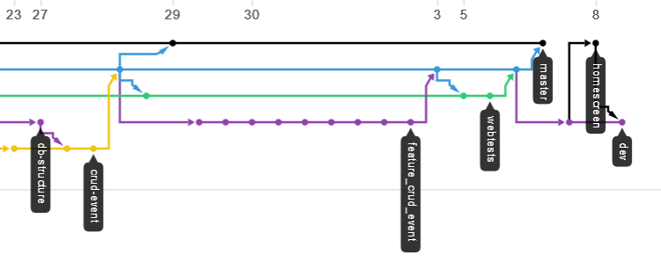

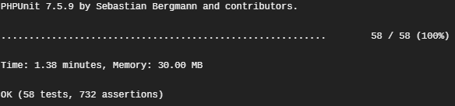
Quality
Multiple branches for different stages → production, development, feature
Pull requests need to be approved by at least another author
Unit tests executed
Continuous integration tests need to succeed before each merge

Slide 16

Live Demo

Slide 17
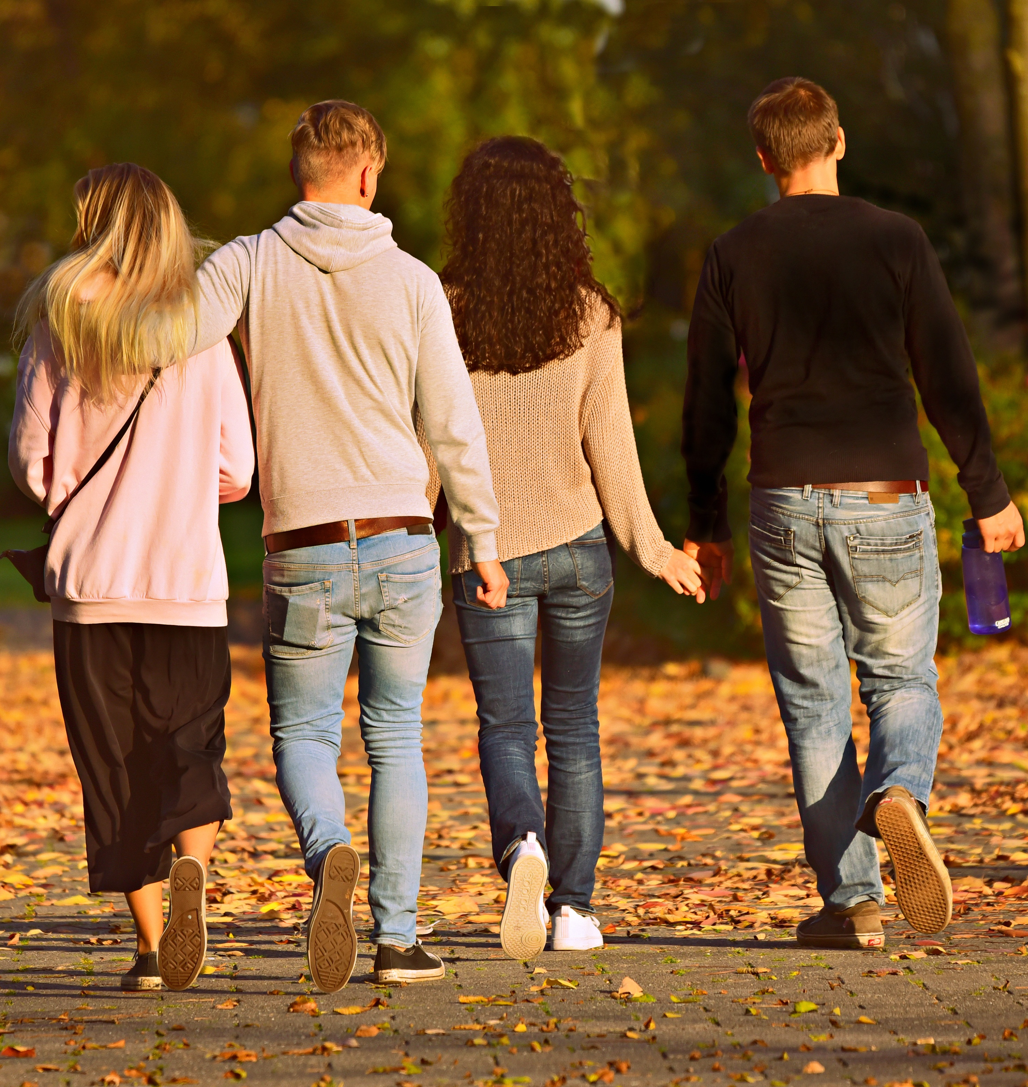

What’s next?
Subscriptions & public calendars
Chat & What-to-bring list
Accepting and declining events
Notifications

Slide 18

Anett Richel
Lukas Qualo
Ben Samtleben
EventLAB. We simplify meeting the world.

